Slide 1
An Overview of Learning to Rank
Yuye

Slide 2
Contents
Introduction
RankNet
LambdaRank
LambdaMART
Conclusions

Slide 3
Contents
Introduction
RankNet
LambdaRank
LambdaMART
Conclusions

Slide 4
Learning to Rank
Learning to rank (LTR) is a class of algorithmic techniques that apply supervised machine learning to solve ranking problems in search relevancy
Two Steps: (1) Decide on the features you want to represent and choose reliable relevance judgments before creating your training dataset. (2) Choose the model to use and the objective to be optimized.

Slide 5
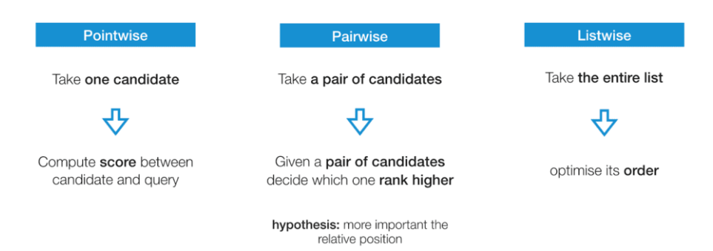
Three approaches
Notes:
1. Pointwise approaches look at a single document at a time using classification or regression to discover the best ranking for individual results. Classification means putting similar documents in the same class. Regression means giving similar documents a similar function value.
2. Pairwise approaches look at two documents together. They also use classification or regression — to decide which of the pair ranks higher.
3. Listwise approaches decide on the optimal ordering of an entire list of documents.

Slide 6
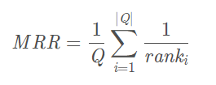
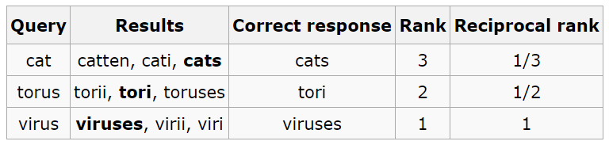
Evaluation Metrics (MRR)
MRR (Mean Reciprocal Rank)

Slide 7
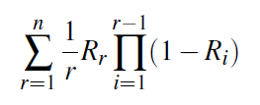
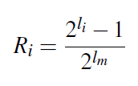

Evaluation Metrics (ERR)
ERR (Expected Reciprocal Rank)
$R_{i}$: the probability that the user finds the document at rank position i relevant

Slide 8
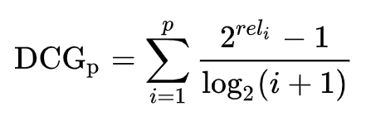
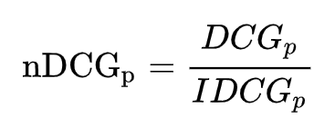
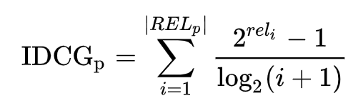
Evaluation Metrics (NDCG)
DCG (Discounted Cumulative Gain)
NDCG (Normalized Discounted Cumulative Gain)

Slide 9
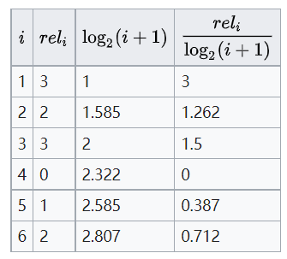
Evaluation Metrics (NDCG)
DCG ?
IDCG?
NDCG?

Slide 10
Contents
Introduction
RankNet
LambdaRank
LambdaMART
Conclusions

Slide 11
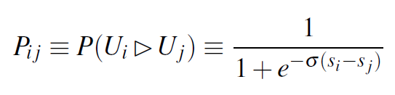

RankNet
Each pair of entries $U_{i}$ and $U_{j}$ with differing labels is chosen, and each such pair (with feature vectors $x_{i}$ and $x_{j}$ ) is presented to the model, which computes the scores $s_{i}=f(x_{i}$) and $s_{j}=f(x_{j}$)
The probability that $U_{i}$ should be ranked higher than $U_{j}$ (the choice of the parameter σ determines the shape of the sigmoid):

Slide 12

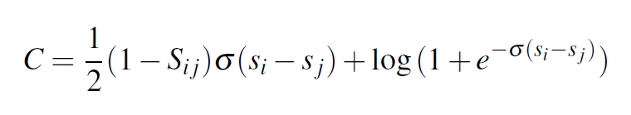

RankNet
${\overline{P}}_{ij}$: the known probability that training data $U_{i}$ should be ranked higher than $U_{j}$
Cross entropy cost function
$S_{ij}$from $\{−1,0,1\}$ and ${\overline{P}}_{ij}$ = (1 + $S_{ij}$) / 2

Slide 13
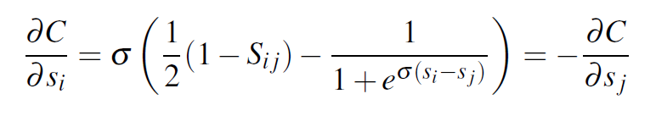
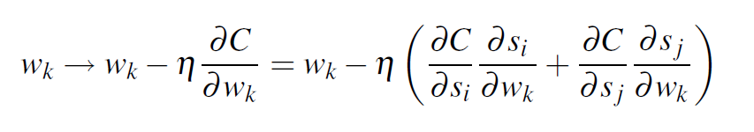

RankNet
${\overline{P}}_{ij}$: the known probability that training data $U_{i}$ should be ranked higher than $U_{j}$
Update the weights to reduce the cost via stochastic gradient descent

Slide 14
Contents
Introduction
RankNet
LambdaRank
LambdaMART
Conclusions

Slide 15
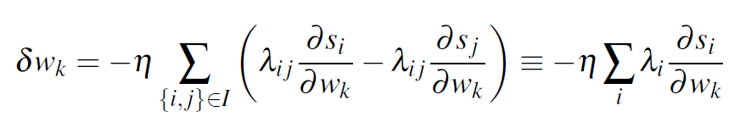
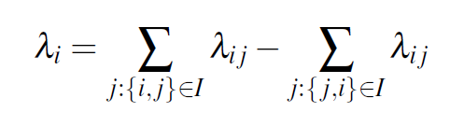

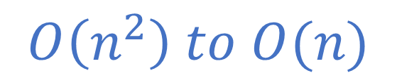
Speeding up RankNet Training
Let $I$ denote the set of pairs of indices $\{i,j\}$, summing all the contributions to the update of weight $w_{k}$
| $I$| = 3? Time Complexity?
$$O\left(n^{2}\right) to O(n)$$

Slide 16
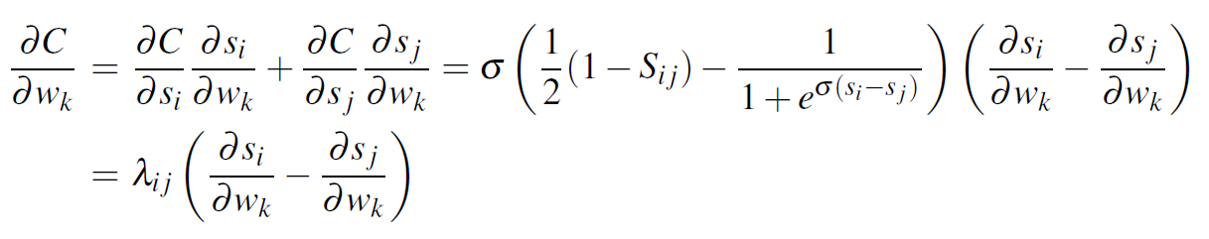
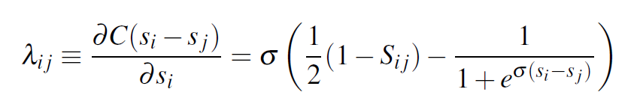
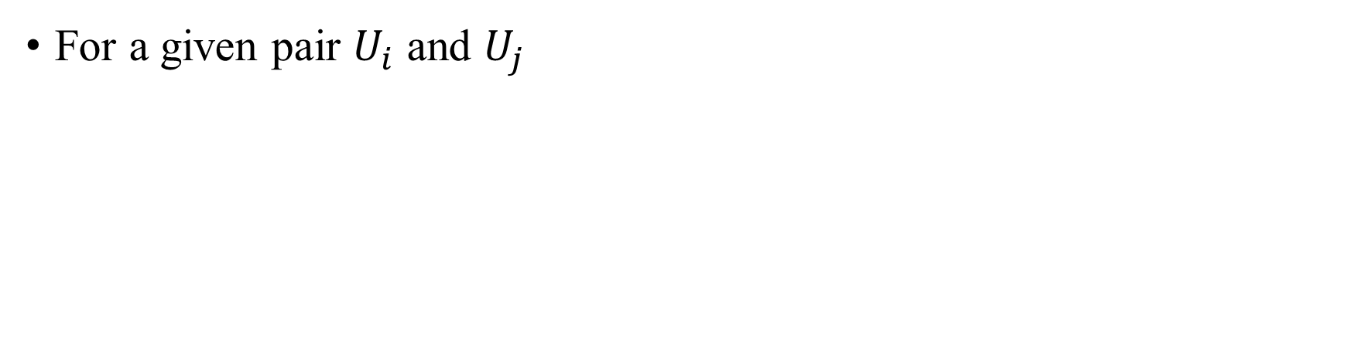
Speeding up RankNet Training
For a given pair $U_{i}$ and $U_{j}$

Slide 17
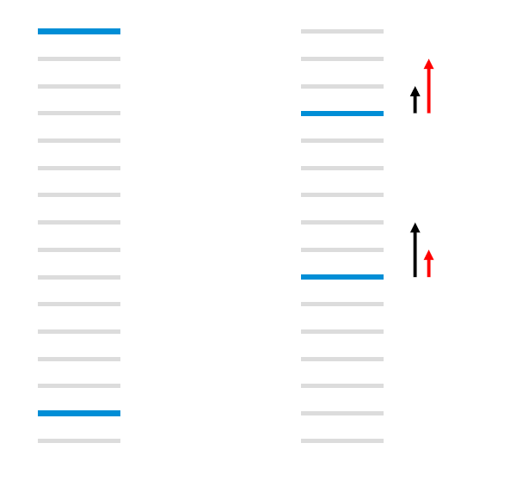
Example
Notes:
The light gray bars represent urls that are not relevant to the query, while the dark blue bars represent urls that are relevant to the query
However for IR measures like NDCG and ERR that emphasize the top few results
The (black) arrows on the left denote the RankNet gradients (which increase with the number of pairwise errors), whereas what we’d really like are the (red) arrows on the right

Slide 18

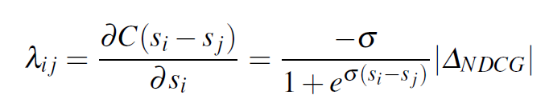
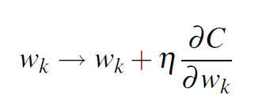
LambdaRank
RankNet:
For LambdaRank, imagine that there is a utility function C:

Slide 19
Contents
Introduction
RankNet
LambdaRank
LambdaMART
Conclusions

Slide 20
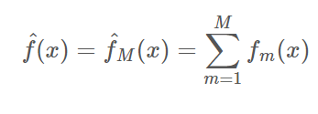
LambdaMART (LambdaRank + MART)
The boosted tree version of LambdaRank
MART (Multiple Additive Regression Trees)

Slide 21
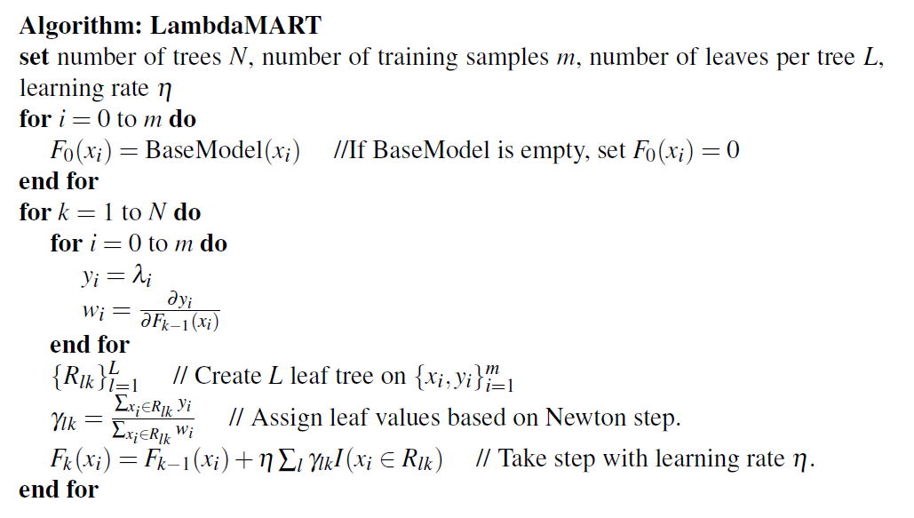
LambdaMART (LambdaRank + MART)

Slide 22
Q&A

